Slide 1

Department of Computer Science & Engineering
(Artificial Intelligence & Machine Learning)
A. P. Shah Institute of Technology
G. B. Road, Kasarvadavali, Thane(W), Mumbai- 400615
UNIVERSITY OF MUMBAI
Academic Year- 2023-2024

Slide 2
DESKTOP ASSISTANT
Computer Science & Engineering
(Artificial Intelligence & Machine Learning)
By
Ritik Pandey (22106054)
Om Panchal (22106025)
Hrishikesh Kharkar (22106002)
Bhushan Khopkar (22106099)

Slide 3
Index
Introduction
Objective
Languages and Software Used
Algorithm
Use Case Diagram
Applications
Conclusion
References

Slide 4
Introduction
Desktop Assistant enhances efficiency by automating tasks and simplifying interactions with your computer.
It seamlessly integrates with your favourite applications, making work more fluid and efficient.
Tailored to your needs, Desktop Assistant learns and adapts to optimize your computing experience.

Slide 5
Objective
Develop advanced Natural Language Understanding Algorithms to accurately interpret user commands and queries.
Enable the AI to automate a variety of desktop tasks, including file management, data entry, report generation and more.
Integrate seamlessly with a wide range of desktop applications, including office suites, email clients, web browsers and specialised software.
Automation in work and hence helps in reducing workload on humans.

Slide 6
Languages and Software Used
Language Used
Python
Software Used
VS Code

Slide 7
Basic Speech Recognition Process (Algorithm)
Speech Engine
Audio Input
Acoustic Model
Brings together the acoustic model and the language model to convert spoken language into texts
Identifies the basic sounds that make up the spoken words
The Program takes the audio input of the user
Analog to Digital Signals
Language Model
Output
The analogy signals are converted to digital signals
Determines the most likely sequence of words based on the input from the acoustic model
Returns the desired output

Slide 8
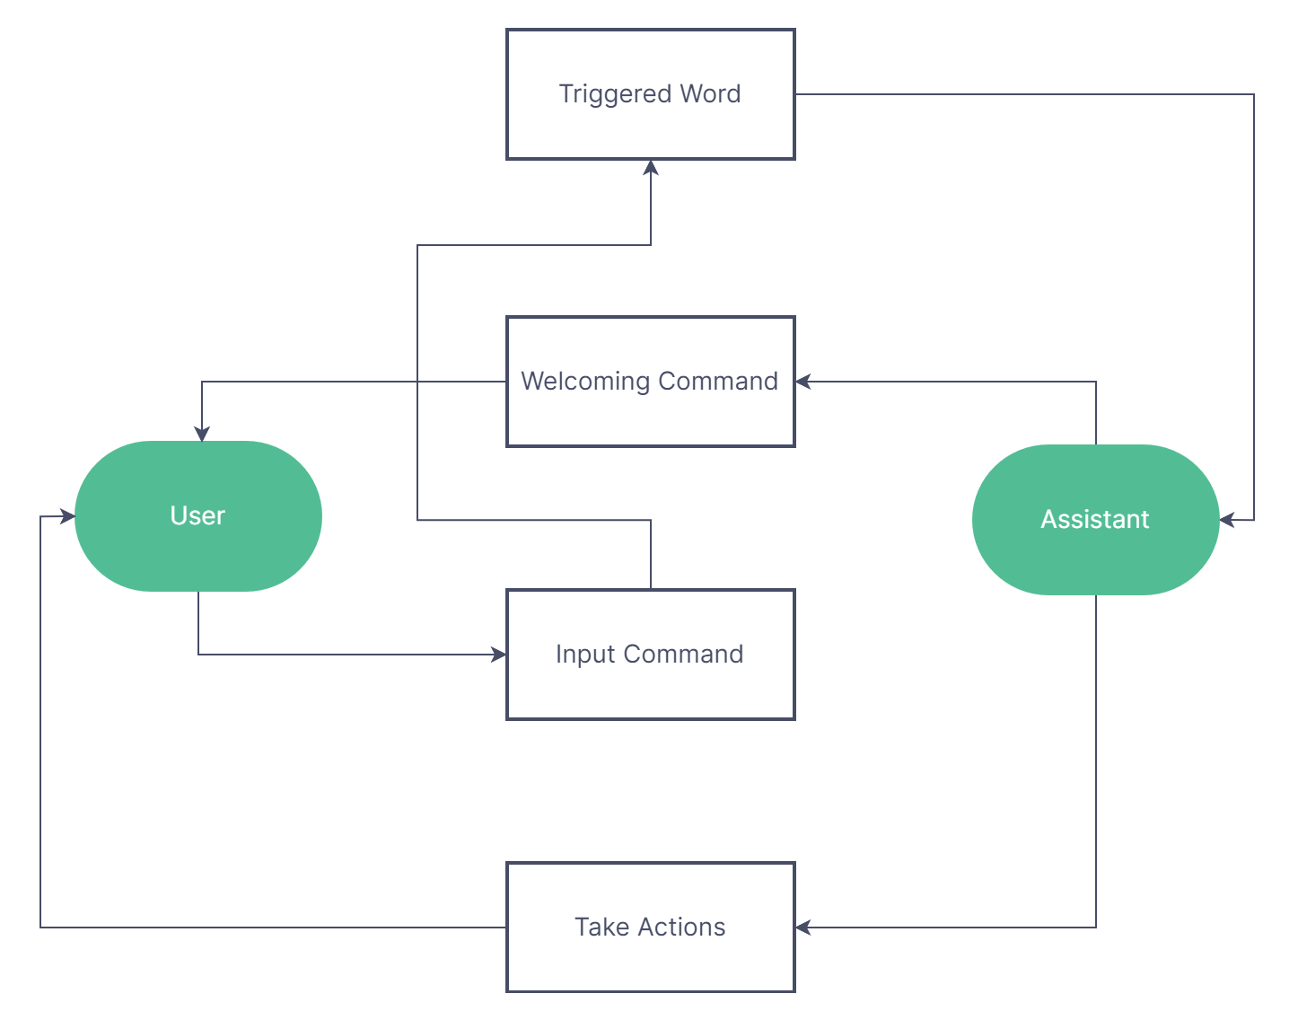
Use Case Diagram

Slide 9




Applications
Seamless Integration
Enhanced Productivity
By seamlessly integrating with a variety of desktop applications and services, it offers a unified experience across diverse software tools.
Promises to revolutionize how user can interact with their computers, automating repetitive tasks, etc.
The Future of Computing
User-Centric Approach
Development in this field represents a significant step towards a more intelligent, user centric and automated future of computing
Customization, personalization, and continuous learning ensure that the AI adapts to individual user needs, enhancing the user experience.

Slide 10
Conclusion
Desktop assistants have evolved into indispensable tools that enhance user productivity, accessibility, and convenience in a desktop computing environment. These intelligent software solutions provide a wide range of features and capabilities, from voice recognition and natural language processing to task automation and entertainment. Desktop assistants like Siri, Cortana, and Google Assistant, as well as third-party solutions, were widely used to simplify tasks, improve workflow efficiency, and make desktop computing more accessible. They automate repetitive tasks, reducing manual effort and enhancing productivity. Task management, email assistance, document creation, and file organization enhance efficiency and organization.

Slide 11
References
Artificial Intelligence based Desktop Partner PJAEE, 17(9) (2020) 9817 Artificial Intelligence based Desktop Partner Wasim Alam Rahman1, Partha Pratim Gohain2, Dibya Jyoti Bora3 1,2Student, Assam Kaziranga University, Assam, India 3Department of Information Technology, Assam Kaziranga University,Assam,India.
URL: https://www.researchgate.net/publication/348806620_Artificial_Intelligence_based_Desktop_ Partner
Rabin Joshi, Supriyo Kar, Abenezer Wondimu Bamud and Mahesh T R, (2023). Personal A.I. Desktop Assistant, 2(2), 54-60.
URL: https://www.jetir.org/papers/JETIRFX06069.pdf

Slide 12
THANK YOU

